Slide 1

Frigate: A Fast, In-memory Tool for Counting and Querying K-mers
Gunavaran Brihadiswaran and Sanath Jayasena
Department of Computer Science and Engineering, University of Moratuwa, Sri Lanka
2021 13th International Conference on Bioinformatics and Biomedical Technology
Xi’an, China, May 21-23, 2021

Slide 2
INTRODUCTION
k-mers are subsequences of length k
DNA Sequence
A
C
G
A
G
G
T
A
C
G
A
A
C
G
A
C
G
A
G
G
A
G
G
4-mers
A
G
G
T
G
G
T
A
G
T
A
C
T
A
C
G
A
C
G
A

Slide 3
INTRODUCTION
(cont’d)
k-mer counting is the process of computing the frequency of each k-mer
DNA Sequence
A
C
G
A
G
G
T
A
C
G
A
K-mer | Count
ACGA | 2
CGAG | 1
GAGG | 1
AGGT | 1
GGTA | 1
GTAC | 1
TACG | 1
A
C
G
A
C
G
A
G
G
A
G
G
4-mers
A
G
G
T
G
G
T
A
G
T
A
C
T
A
C
G
A
C
G
A

Slide 4
INTRODUCTION
(cont’d)
From an algorithmic point of view, k-mer counting is simple and straightforward
Development of Next Generation Sequencing technologies has resulted in a tremendous growth of genomic data
Processing large amounts of sequence data (hundreds or thousands of gigabytes) with limited resources within limited time is a challenge

Slide 5
INTRODUCTION
(cont’d)
K-mer counting is a pivotal step in many bioinformatics applications
Genome assembly (R. Li et al. 2010; Meng et al. 2014)
Sequence error correction(Kelley, Schatz, and Salzberg 2010; Y. Liu, Schröder, and Schmidt 2013)
Repeat detection (Kurtz et al. 2008; Price, Jones, and Pevzner 2005)
Multiple sequence alignment (Edgar 2004)
Hence, accelerating k-mer counting would benefit a wide range of applications that utilize it
* Please see the last slide for references

Slide 6
INTRODUCTION
(cont’d)
Some existing k-mer counters
Jellyfish, DSK, Gerbil, KMC3, CHTKC
State-of-the-art k-mer counters are optimized for large k-values (k>=20) which impose undesired overhead when processing small k values (k < 20)
We present Frigate, a fast in-memory tool for counting and querying k-mers in a shared memory environment

Slide 7

METHODOLOGY
Frigate’s parallel processing pipeline
0
Counter_0
Writer_0
FASTQ file
Counter_1
Writer_1
Reader
Counter_n
Writer_n+1
4^{k}-1
K-mer queues
Binary output files
Counter array

Slide 8
METHODOLOGY
(cont’d)
Binary encoding
0
1
2
3
4
5
6
7
8
9
10
11
12
13
14
15
C
T
C
T
T
A
A
T
C
T
C
T
T
G
T
C
A - 00
C - 01
G - 10
T - 11
0
1
1
1
0
1
1
1
1
1
0
0
0
0
1
1
0
1
1
1
0
1
1
1
1
1
1
0
1
1
0
1
1 byte
Reduces memory consumption by 75%
K-mers can be processed as unsigned integers rather than as strings

Slide 9
METHODOLOGY
(cont’d)
Counter array
0
4^{k}-1
0
0
0
0
0
0
0
0
0
0
TGAACG
Eliminate the need to store the k-mers
111000000110
O(1) access time complexity
3590
STORE IN 3590TH INDEX

Slide 10
METHODOLOGY
(cont’d)
Canonical k-mer counting
TGAACG
CGTTCA
00
00
11
10
00
00
01
10
00
00
01
10
11
11
01
00
TGAACGCT...
>> 2 bits
TGAACG
00
00
00
10
00
00
01
10
GAACGC
00
00
00
01
10
11
11
01
<< 2 bits
00
00
10
00
00
01
10
00
00
00
10
01
10
11
11
01
GCGTTC
00
00
10
00
00
01
10
01
GAACGC

Slide 11
METHODOLOGY
(cont’d)
(cont’d)
Canonical k-mer counting
Cache efficient
Benefits from prefetching
Bitwise operations are fast

Slide 12
METHODOLOGY
(cont’d)
Storing the counting results
The counter array must be traversed to filter non-zero counts
Thread_0
Thread_1
Thread_2
Thread_3
Approach_1
0
4^{k}-1
Approach_2
0
4^{k}-1

Slide 13
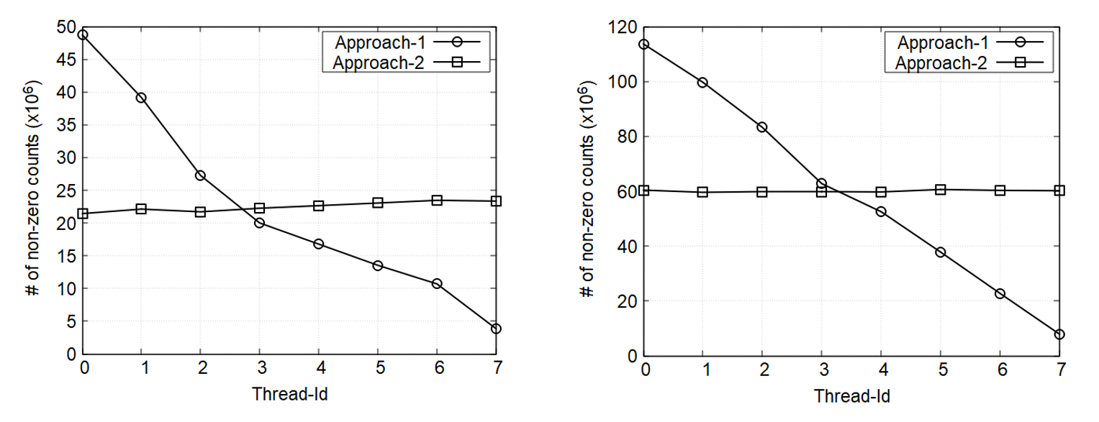
METHODOLOGY
(cont’d)
Storing the counting results
k=15, F.vesca dataset
k=15, H.sapiens dataset
Better workload balance
Better workload balance

Slide 14
METHODOLOGY
(cont’d)
Frigate uses compare-and-swap (CAS) technique for thread synchronization (typically faster than locking(Gramoli 2015))
Frigate is also capable of querying the k-mer counts
V. Gramoli, “More than you ever wanted to know about synchronization: synchrobench, measuring the impact of the synchronization on concurrent algorithms,” in Proceedings of the 20th ACM SIGPLAN Symposium on Principles and Practice of Parallel Programming, San Francisco CA USA, Jan. 2015, pp. 1–10, doi: 10.1145/2688500.2688501.

Slide 15
RESULTS AND DISCUSSION
Datasets
Organism | Genome Size (Mb) | No. of bases (Gb) | FASTQ file size (GB) | Average read length (bases) | No. of reads
F. vesca (FV) | 214 | 4.5 | 10.9 | 353 | 12,803,137
H. sapiens (HS) | 2,991 | 123.7 | 292.1 | 151 | 819,148,264
To understand the influence of data size on the behavior of algorithms

Slide 16
RESULTS AND DISCUSSION
(cont’d)
We compared Frigate with five state-of-the-art algorithms: DSK, Gerbil, CHTKC, KMC2 and KMC3
The experiments were carried out for k values of 10, 15, and 17

Slide 17
RESULTS AND DISCUSSION
(cont’d)
K = 15
K = 17
k = 15, F.vesca
# Threads | DSK | Gerbil | CHTKC | KMC3 | KMC2 | Frigate
1 | 6,510 | - | - | 617 | 531 | 276
2 | 3,508 | - | - | 442 | 383 | 197
4 | 1,695 | 174 | 973 | 203 | 183 | 121
8 | 948 | 79 | 937 | 115 | 102 | 66
16 | 573 | 51 | 179 | 74 | 68 | 39
32 | 496 | 44 | 80 | 59 | 52 | 26
k = 17, F.vesca
# Threads | DSK | Gerbil | CHTKC | KMC3 | KMC2 | Frigate
1 | 6,754 | - | - | 652 | 559 | 823
2 | 3,389 | - | - | 451 | 392 | 464
4 | 1,779 | 198 | 1,849 | 207 | 187 | 284
8 | 936 | 81 | 1,192 | 116 | 106 | 187
16 | 481 | 46 | 250 | 75 | 67 | 117
32 | 397 | 43 | 114 | 55 | 49 | 79
k = 15, H.sapiens
# Threads | DSK | Gerbil | CHTKC | KMC3 | KMC2 | Frigate
2 | 85,377 | - | - | 9,375 | 8,000 | 4,800
4 | 40,868 | 5,311 | 24,901 | 4,600 | 4,825 | 3,071
8 | 26,398 | 4,241 | 18,776 | 4,899 | 4,982 | 1,830
16 | 19,340 | 4,319 | 3,963 | 4,346 | 4,781 | 1,610
32 | 15,871 | 4,297 | 1,725 | 4,151 | 5,247 | 1,561
k = 17, H.sapiens
# Threads | DSK | Gerbil | CHTKC | KMC3 | KMC2 | Frigate
2 | 74,916 | - | - | 9,726 | 8,192 | 7,611
4 | 40,215 | 7,572 | 94,028 | 5,148 | 4,516 | 6,842
8 | 24,556 | 4,702 | 23,475 | 4,149 | 3,903 | 3,607
16 | 16,602 | 4,130 | 5,475 | 3,912 | 3,890 | 1,694
32 | 13,246 | 4,095 | 2,283 | 3,583 | 4,057 | 1,681
Frigate outperforms its competitors (up to 2-3x speedup) in most of the cases,
especially for the large dataset

Slide 18
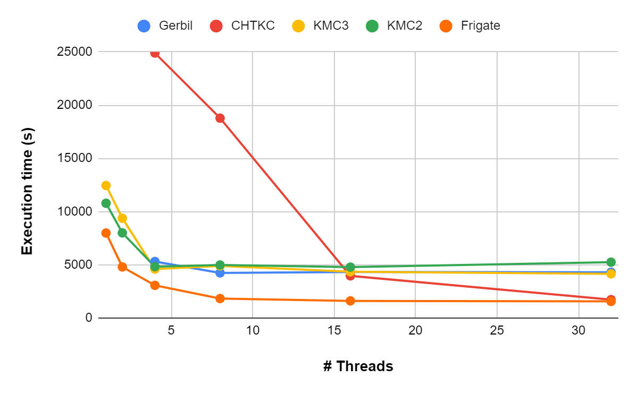
RESULTS AND DISCUSSION
(cont’d)
15-mer counting for H. sapiens dataset

Slide 19
CONCLUSION AND FUTURE WORK
We presented Frigate, a tool capable of counting and querying k-mers for small k values with a vision of using different algorithms for different ranges of k values.
Results show that Frigate achieves comparable performance or speedup up to 2-3x compared to the state of the art k-mer counters
We intend to extend Frigate to process large values of k

Slide 20
THANK YOU
Available at https://github.com/Gunavaran/frigate

Slide 21
REFERENCES
R. Li et al., “De novo assembly of human genomes with massively parallel short read sequencing,” Genome Research, vol. 20, no. 2, pp. 265–272, Feb. 2010, doi: 10.1101/gr.097261.109.
J. Meng, B. Wang, Y. Wei, S. Feng, and P. Balaji, “SWAP-Assembler: scalable and efficient genome assembly towards thousands of cores,” BMC Bioinformatics, vol. 15, no. Suppl 9, p. S2, 2014, doi: 10.1186/1471-2105-15-S9-S2.
D. R. Kelley, M. C. Schatz, and S. L. Salzberg, “Quake: quality-aware detection and correction of sequencing errors,” Genome Biology, vol. 11, no. 11, p. R116, 2010, doi: 10.1186/gb-2010-11-11-r116.
Y. Liu, J. Schröder, and B. Schmidt, “Musket: a multistage k-mer spectrum-based error corrector for Illumina sequence data,” Bioinformatics, vol. 29, no. 3, pp. 308–315, Feb. 2013, doi: 10.1093/bioinformatics/bts690.
S. Kurtz, A. Narechania, J. C. Stein, and D. Ware, “A new method to compute K-mer frequencies and its application to annotate large repetitive plant genomes,” BMC Genomics, vol. 9, no. 1, p. 517, 2008, doi: 10.1186/1471-2164-9-517.
A. L. Price, N. C. Jones, and P. A. Pevzner, “De novo identification of repeat families in large genomes,” Bioinformatics, vol. 21 Suppl 1, pp. i351-358, Jun. 2005, doi: 10.1093/bioinformatics/bti1018.
R. C. Edgar, “MUSCLE: multiple sequence alignment with high accuracy and high throughput,” Nucleic Acids Res, vol. 32, no. 5, pp. 1792–1797, 2004, doi: 10.1093/nar/gkh340.

